Slide 1
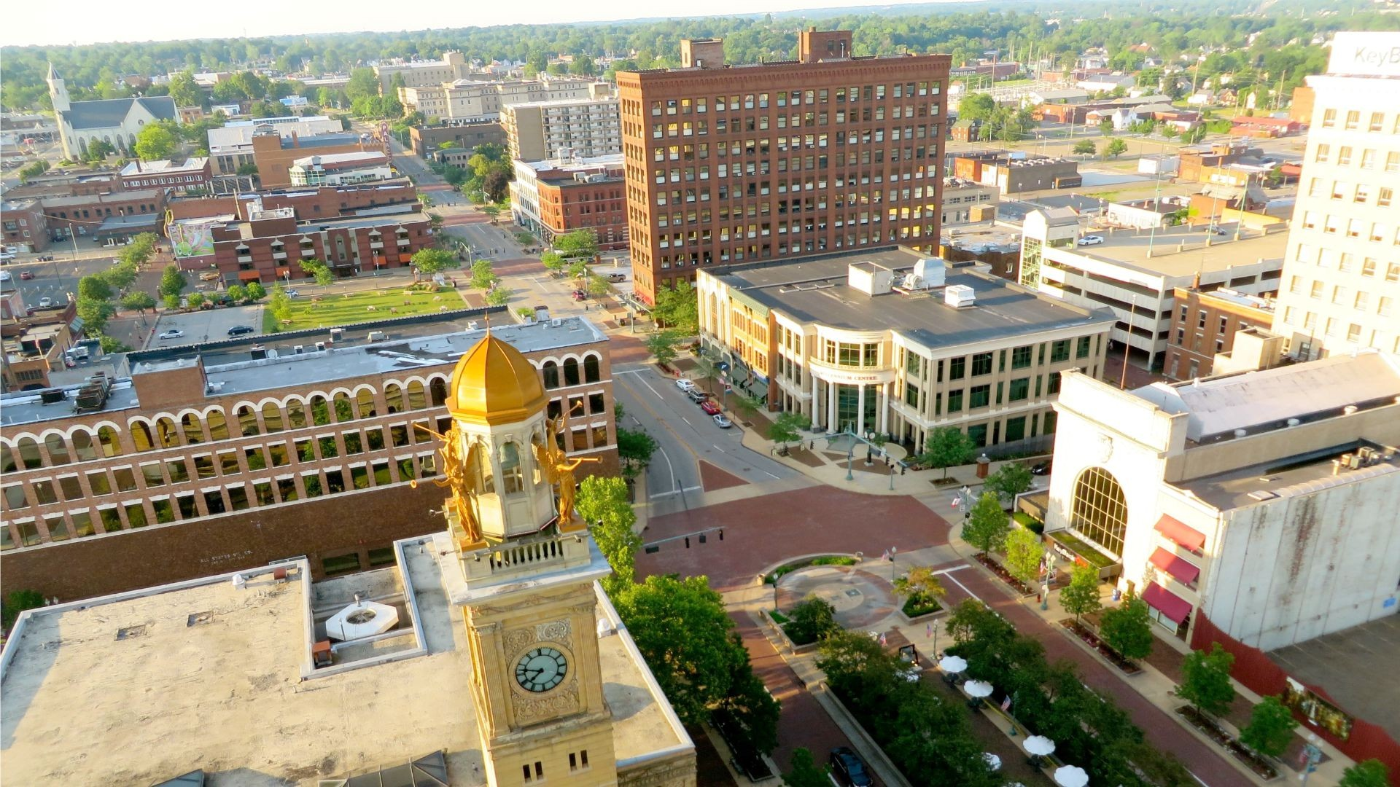
Notes:
Greeting from the Hall of Fame City!

Slide 2
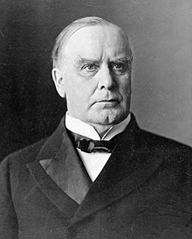
Proud History
President William McKinley
Notes:
The City of Canton has a very proud history;
The City is the adopted home of 25th U.S. President William McKinley
He conducted the famed front porch campaign, which won him the presidency of the United States in the 1896 election, from his home in Canton.
The McKinley National Memorial and the William McKinley Presidential Library and Museum commemorate his life and presidency are located in Canton

Slide 3
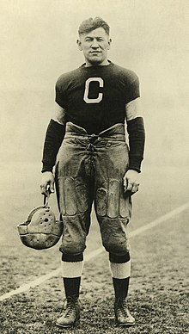
Proud History
James Francis Thorpe
Notes:
The City of Canton has a proud football history
In 1920 in Canton Ohio the American Professional Football was founded
The name was changed to the National Football League in 1922
Jim Thorpe was the league’s first president
He was an American athlete and Olympic gold medalist. A member of the Sac and Fox Nation, Thorpe became the first Native American to win a gold medal for the United States

Slide 4
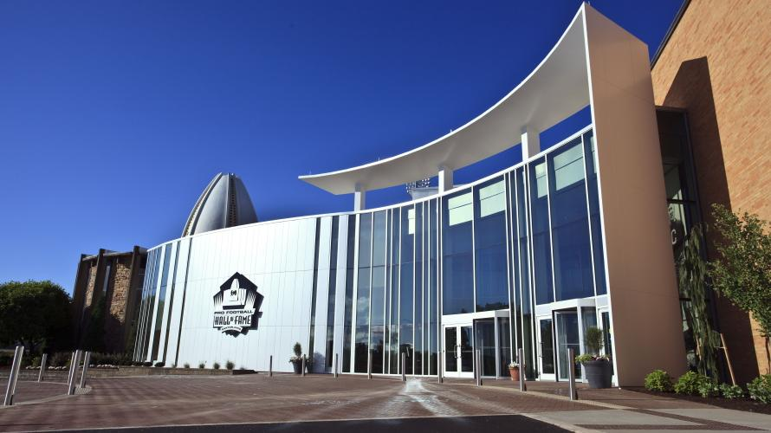
Proud History
Pro Football Hall of Fame
Notes:
Canton is the home of the Pro Football Hall of Fame. It formally opened in 1963.
Over 13 million people have visited the Pro Football Hall of Fame

Slide 5
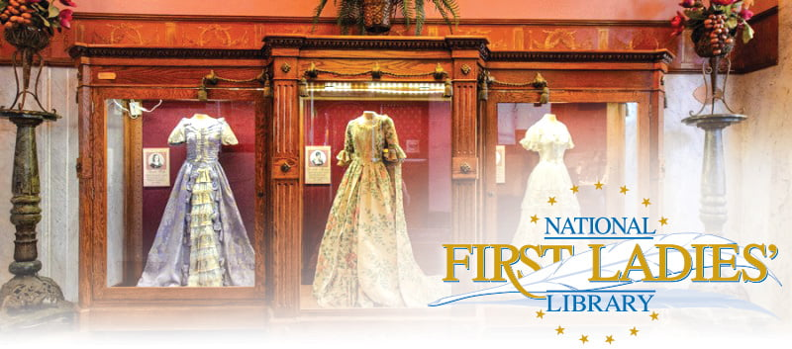
Notes:
Canton is home to the National First Ladies’ Library
The site’s mission is to preserve, promote and education about the significant role of First Ladies in American history.

Slide 6
Canton, Ohio
Demographic Information

Slide 7
Canton Facts
Current population: 73,000
Highest population: 1950- 116,000
White- 74%
Black- 21%
Other- 5%
LMI- 62% and school district- 100% free or reduced lunch
4 high schools to 1 high school
Homeownership rate is 47.7%
The national homeownership rate is 63.9%
Notes:
Current population: 73,000
Highest population: 1950- 116,000 - a loss of 43,000 people
The City is
White- 74%
Black- 21%
Other- 5%
The City LMI- 62% and the school district- 100% free or reduced lunch
The City went from 4 high schools to 1 high school
The Homeownership rate is 47.7%
The national homeownership rate is 63.9%

Slide 8
Economy
Proud Industrial History
Timken Company - roller bearings
Republic Steel
Hoover Company - vacuum cleaners
Diebold - Maker of the ATM
1970s : lost it’s downtown retail sector to the suburbs - like many mid-size cities
Notes:
Proud Industrial History - the home of several national companies
Timken Company - roller bearings
Republic Steel
Hoover Company - vacuum cleaners
Diebold - Maker of the ATM
The City in the 1970s : lost it’s downtown retail sector to the suburbs - like many mid-size cities

Slide 9
Renaissance
Service and Healthcare - major employers
Pro Football Hall of Fame - billion dollar expansion underway
High-end downtown housing
Downtown - designated an arts and entertainment district
City first in Ohio to create a “designated outdoor refreshment area - allowing open container of alcoholic beverages downtown
Centennial Plaza - a 13 million dollar, 2 acre open air entertainment area highlighting pro football history
Gervasi Vineyard - premier winery and resort - multiple restaurants and villas
Notes:
During the past decade Canton has come to experience a renaissance
Know the Service and Healthcare sectors are major employers
Pro Football Hall of Fame has a billion dollar expansion underway – hotel, amusement park, residential, injury study center
High-end downtown housing
Downtown - designated an arts and entertainment district
City first in Ohio to create a “designated outdoor refreshment area - allowing open container of alcoholic beverages downtown
Centennial Plaza - a 13 million dollar, 2 acre open air entertainment area highlighting pro football history opened this spring
Gervasi Vineyard - premier winery and resort - multiple restaurants and villas

Slide 10
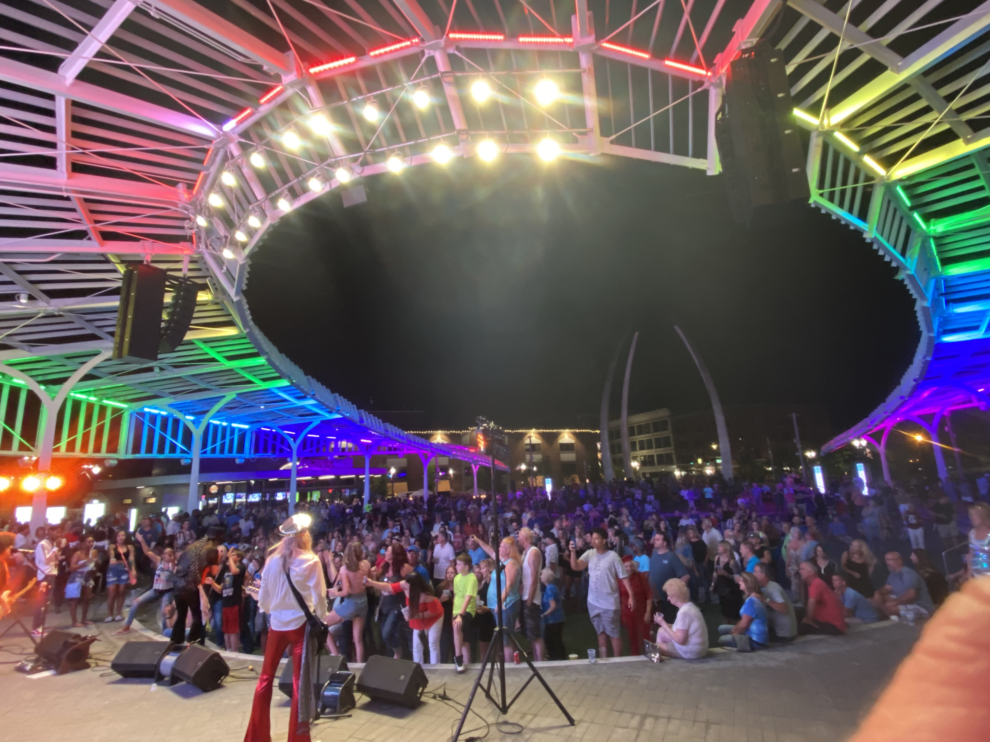
Notes:
This photo was taken at the beginning of this year’s pride month – basically the grand opening of Centennial Plaza – a huge success!

Slide 11
CDBG Allocation
2021 - $2.5 million
15% Public Service Cap - $375,000
Lots of competition for public service projects
Partnered with local community foundation for a two year capacity building program
First Year - $30,000 CDBG
Second Year - $30,000 Foundation Funds

Slide 12
Capacity Building Program Design
$30,000 - in the 2021 Action Plan
Public Service Activity
Matrix Code- 05Z
National Objective: LMC
Track beneficiaries of nonprofits in the program
Program year begins – April 1
Line of credit expected late summer early fall
Notes:
Capacity Building Program Design
$30,000 - in the 2021 Action Plan
Public Service Activity
Matrix Code- 05Z – the catch all matrix code for public service if no other code works
National Objective: LMC
Track beneficiaries of nonprofits in the program
Program year begins – April 1 – of course we got our allocation notice late – so we accept
Line of credit expected late summer early fall

Slide 13
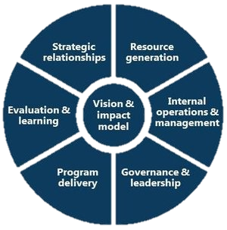
Program Components
Strategic Relationships
Resource Generation
Internal Operations & Management
Governance & Leadership
Program Delivery
Evaluation & Learning
Vision & Impact Model
Notes:
Program Components
$30,000 - in the 2021 Action Plan
Public Service Activity
Matrix Code- 05Z
National Objective: LMC
Track beneficiaries of nonprofits in the program
Program year begins – April 1
Line of credit expected late summer early fall

Slide 14
Barriers and Perceptions
Small City - lots of history among the nonprofit community
Black and Brown nonprofits feel discriminated in funding decisions by:
Local United Way
Local community foundations
Local mental health and recovery board
Funders perceive negative history with black and brown nonprofits
Lack of leadership change in the local nonprofit community
Notes:
Barriers and PerceptionsSmall City - lots of history among the nonprofit community
Black and Brown nonprofits feel discriminated in funding decisions by:
Local United Way
Local community foundations
Local mental health and recovery board
Funders perceive negative history with black and brown nonprofits
Lack of leadership change in the local nonprofit community

Slide 15
Negotiations with Local Foundation
Overcome negative perceptions due to past history
Positive working relationship with local community foundation
We agreed to the following:
Joint approval on contractor for the capacity building and technical assistance
Joint selection of agencies that will be in the program
Notes:
Negotiations with Local Foundation
Overcome negative perceptions due to past history
Positive working relationship with local community foundation
We agreed to the following:
Joint approval on contractor for the capacity building and technical assistance
Joint selection of agencies that will be in the program

Slide 16
Benefits of Changing the Public Service Cap- COVID Funding
Able to address racial education gap:
Chrome books
Case management to get working high school students on track to graduate
Remedial education programming
Notes:
Benefits of Changing the Public Service Cap- COVID
Able to address racial education gap:
Chrome books
Case management to get working high school students on track to graduate
Remedial education programming
In response to COVID – minority students falling behind – last of internet access for remote learning and learning environment chanlleges

Slide 17
Current Public Service Cap Exemption
Public Services carried out in a NRSA (Neighborhood Revitalization Strategy Area) are not subject to the statutory 15% public service cap when such activities are carried out by a designated Community Based Development Organization undergoing a neighborhood revitalization, community economic development, or energy conservation program.
Notes:
Current Public Service Cap Exemption
Public Services carried out in a NRSA (Neighborhood Revitalization Strategy Area) are not subject to the statutory 15% public service cap when such activities are carried out by a designated Community Based Development Organization undergoing a neighborhood revitalization, community economic development, or energy conservation program.
We have addressed food insecurity, community gardens, and remedial education via programming with a CDBO

Slide 18
Rollin Seward
Director, Community Development, City of Canton
Email: rollin.seward@cantonohio.gov
Phone: 330.438.4111

